Slide 1
Section 1: Viruses
Key Targets
Determine how viruses are like organisms
Describe the structure of a virus and how they multiply
Determine how to treat a viral disease
Key Vocabulary
Virus, Host, Parasite, Bacteriophage, Vaccine

Slide 2
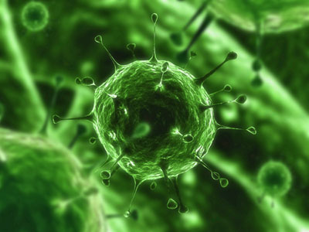
Characteristics of Viruses
One of the main types of germs that makes the body ill are viruses
A virus is a tiny, nonliving particle that invades and then multiplies inside a living cell
Viruses are not cells
The only way viruses are like organisms is that they can multiply
Viruses can only multiply when they are inside a living cell

Slide 3
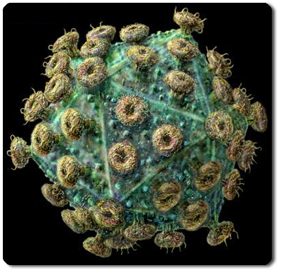
Characteristics of Viruses
No organisms are safe from viruses
A host is a living thing that provides a source of energy for a virus or an organism
Viruses act like parasites
Parasites are organisms that live on or in a host and cause it harm
Almost all viruses destroy their host cells

Slide 4
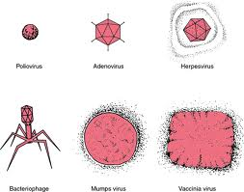
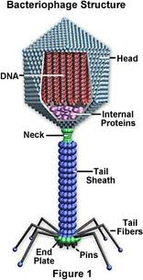
The Structure of Viruses
Viruses are smaller than cells and vary in size and shape
A bacteriophage is a virus that infects bacteria
All viruses have two basic parts:
A protein coat that protects the virus
An inner core made of genetic material

Slide 5
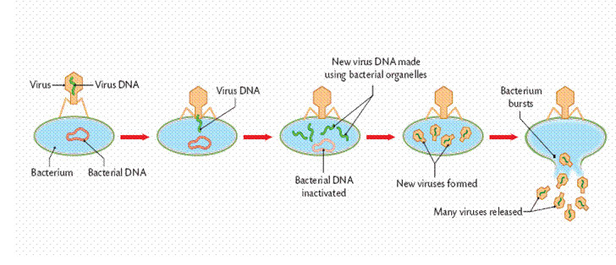
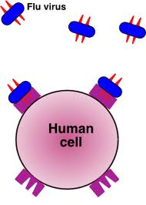
The Structure of Viruses
The shape of surface proteins allow the virus to attach to certain cells in the host
Because the lock and key action of a virus is specific, a certain virus can attach only to one or a few types of cells

Slide 6
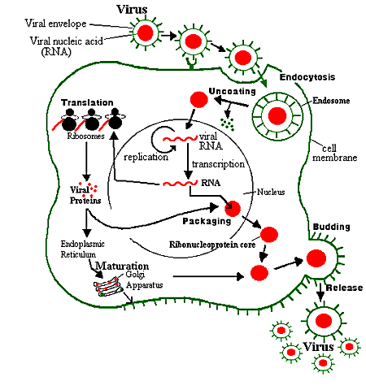
How Viruses Multiply
After a virus attaches to a host cell, it enters the cell
Once inside a cell, a virus’s genetic material takes over many of the cells functions.
It instructs the cell to produce the virus’s proteins and genetic material
These proteins and genetic material then assemble into new viruses

Slide 7
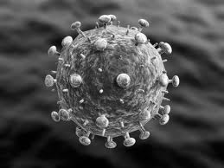
Active Viruses
After entering a cell, an active virus immediately goes into action
Like a photocopy machine, the invaded cell makes copy after copy of new viruses
When it is full of new viruses, the host cell bursts open, releasing hundreds of new viruses as it dies

Slide 8
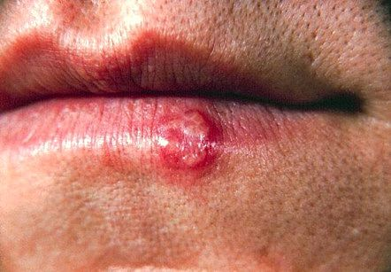
Hidden Viruses
Other viruses “hide” for a while, sometime even years
Each time the host cell divides, the virus’s genetic material is copied along with the hosts genetic material
Under certain conditions, the virus’s genetic material suddenly becomes active for a period of time
Cold sores are an example of a hidden virus

Slide 9
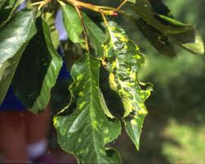
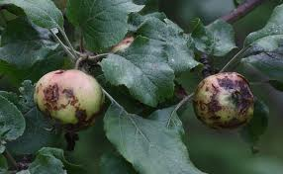
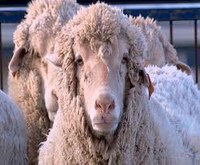
Viruses and Disease
Viruses can cause disease
Some diseases are mild, but others can have much more serious consequences on the body
Viruses can also cause diseases in organisms other than humans

Slide 10
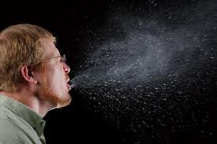
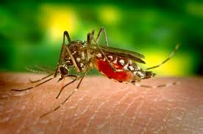
The Spread of Viral Diseases
Viral diseases can be spread in various ways
Contact with a contaminated object
The bite of an infected animal
Travel in tiny drops of moisture that an infected person sneezes or coughs into the air
Contact with bodily fluids, such as blood

Slide 11
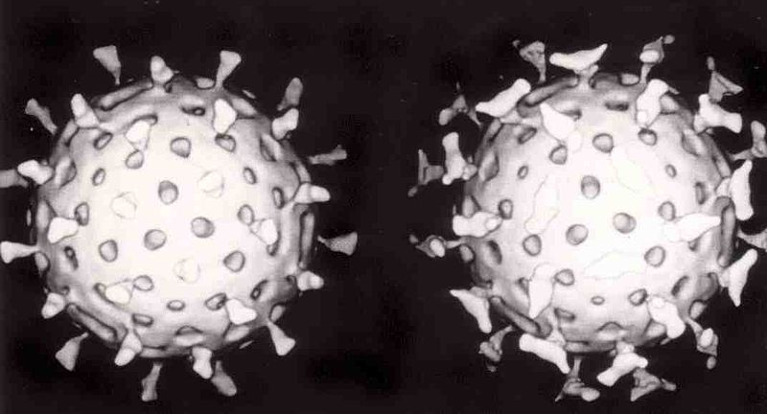
Treating Viral Diseases
There are currently no cures for viral diseases
However, many over the counter medications can help relieve symptoms of a viral infection
While they can make you feel better, these medications can also delay your recovery

Slide 12
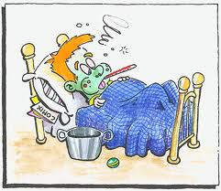
Treating Viral Diseases
The best treatment for viral infections is often bed rest
Resting, drinking plenty of fluids, and eating well balanced meals may be all you can do while you recover from a viral disease

Slide 13
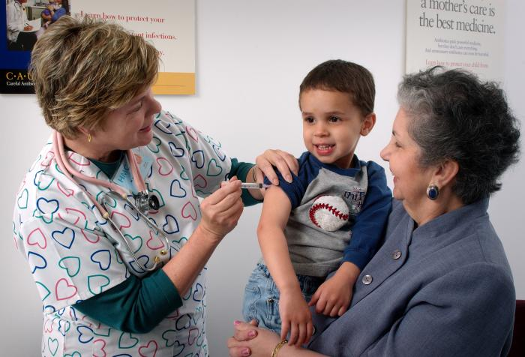
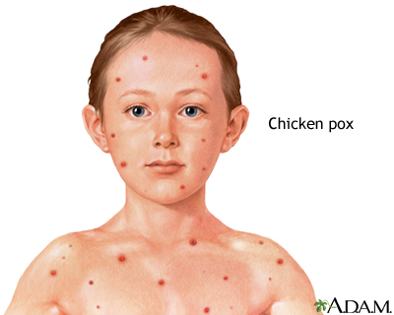
Preventing Viral Diseases
A vaccine is a substance that destroys specific disease causing viruses
A viral vaccine may be made from weakened or altered viruses.
Vaccines trigger the body’s natural defenses and put the body “on alert”
You may have been vaccinated against disease such as polio, measles, and chickenpox

Slide 14
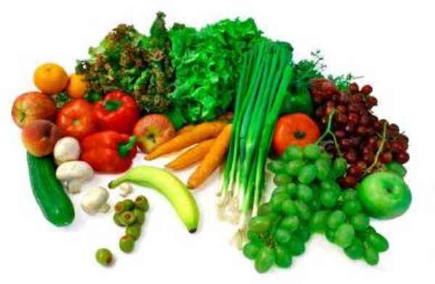
Preventing Viral Diseases
Another important way to protect against viral diseases is to keep your body healthy
You need to eat nutritious food, as well as get enough sleep, fluids, and exercise
You can also protect yourself by washing your hands often and by not sharing eating or drinking utensils

Slide 15
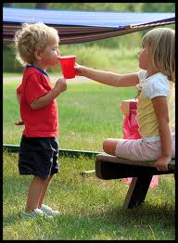
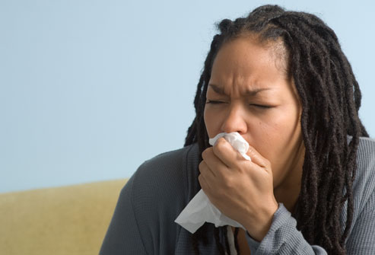
Preventing Viral Diseases
Unfortunately, you'll probably get viral infections from time to time
When you do get ill, get plenty of rest and follow your doctors’ recommendations.
Also, it’s very important to try not to infect others

Slide 16
Section 2: Bacteria
Key Targets
Name and describe the structures, shapes, and sizes of a bacterial cell
Describe what bacteria needs to survive
Describe the conditions under which bacteria thrive and reproduce frequently
Identify the positive roles of bacteria
Key Vocabulary
Bacteria, Flagellum, Binary fission, Asexual reproduction, Sexual reproduction, Conjugation, Endospore, Pasteurization, Decomposer

Slide 17
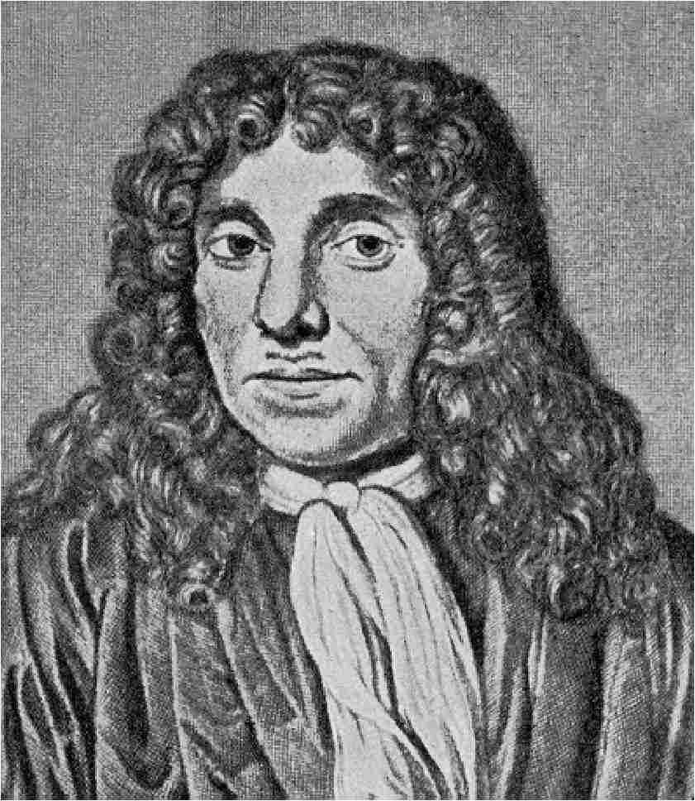
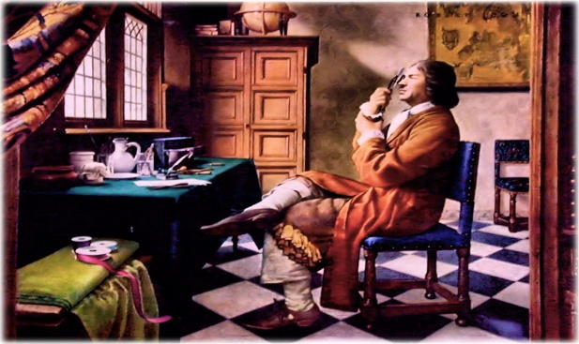
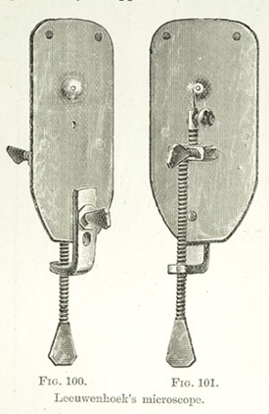
The Bacterial Cell
There is more bacteria in your mouth than there are people on Earth!
In the late 1600s, Anton van Leeuwenhoek discovered bacteria by accident
He saw some tiny, wormlike organisms in a sample from the scrapings from his teeth
Leeuwenhoek's microscopes were not powerful enough to see any details inside these organisms

Slide 18
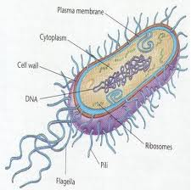
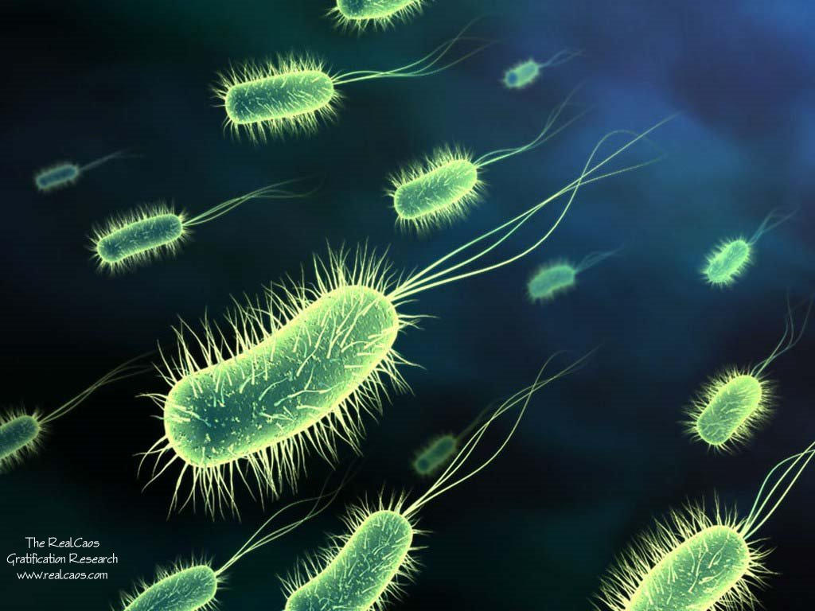
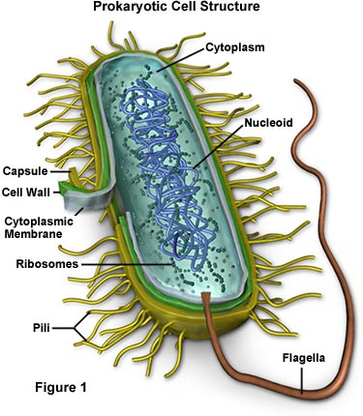
Bacteria Cell Structures
Bacteria is a single celled organism that lack a nucleus
Bacteria are prokaryotes
Most bacterial cells are surrounded by a rigid cell wall, have cytoplasm, a cell membrane, and ribosomes

Slide 19
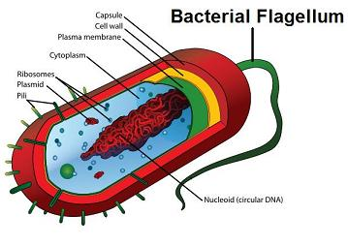
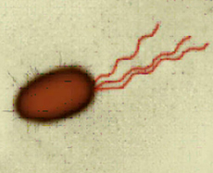
Bacteria Cell Structures
A bacterial cell may also have flagellum
Flagellum is a long, whip like structure that helps a cell to move
A flagellum is similar to a propeller and a bacterial cell can have many, one, or none
Bacteria that doesn’t have a flagellum are carried from place to place by the air, water currents, objects, or other methods

Slide 20
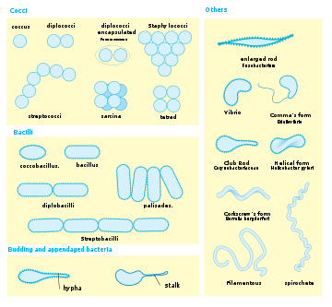
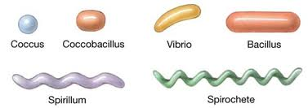
Bacteria Cell Sizes
Bacteria vary greatly in size
The largest bacteria is about as big as a period in your textbook

Slide 21
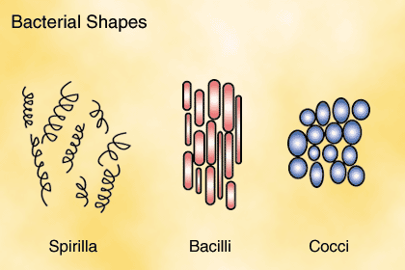
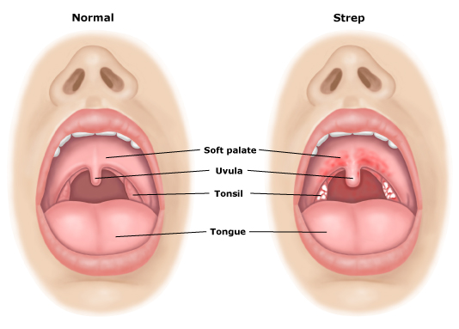
Bacteria Cell Shapes
Bacteria have one of three basic shapes
Spherical
Rod like
Spiral
The chemical makeup of the cell wall determines the shape of the bacterial cell
The shape of the cell helps scientists identify the type of bacteria

Slide 22
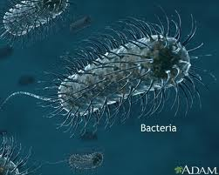
Obtaining Food and Energy
All bacteria need certain things to survive
Bacteria must have a source of food and a way of breaking down the food to release its energy

Slide 23
Obtaining Food
Some bacteria are autotrophs and make their own food.
They capture and use the sun’s energy
Others use the energy from chemical substances in their environment to make food

Slide 24
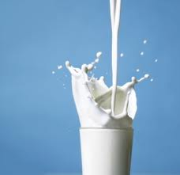
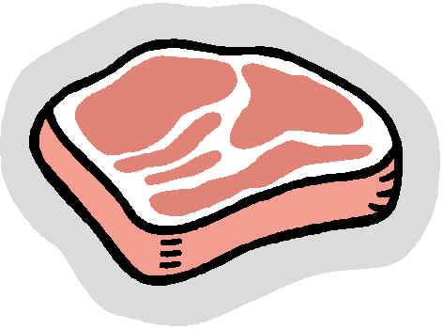
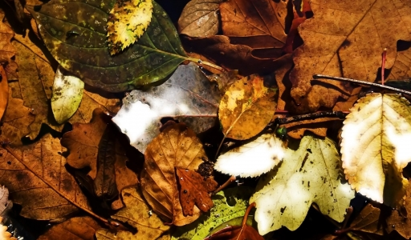
Obtaining Food
Some bacteria are heterotrophs and cannot make their own food
Heterotrophs consume other organisms or the food that other organisms make
Heterotrophic bacteria consume a variety of foods, such as milk, meat, and decaying leaves

Slide 25
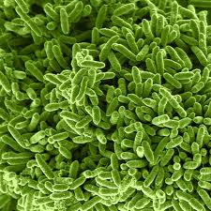
Respiration
Like all organisms, bacteria need a constant supply of energy
This energy comes from breaking down food in the process of respiration
Like many other organisms, most bacteria need oxygen to break down their food
Some bacteria don’t need oxygen for respiration and may die if oxygen is present

Slide 26
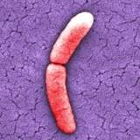
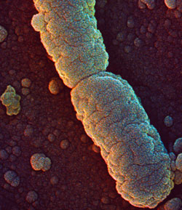
Reproduction
When bacteria have plenty of food, the right temperature, and other suitable conditions, they thrive and reproduce frequently
Some bacteria can reproduce as often as once every 20 minutes
So it’s a good thing that growing conditions for bacteria are rarely ideal

Slide 27
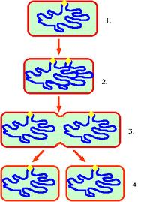
Asexual Reproduction
Binary fission is when one cell divides to make two identical cells
Asexual reproduction is a reproductive process that involves only one parent and produces offspring that are identical to the parent
During binary fission, a cell first duplicates its genetic material and then divides into two separate cells
Each new cell gets it own complete copy of the parents genetic material as well as some of the parents ribosomes and cytoplasm

Slide 28
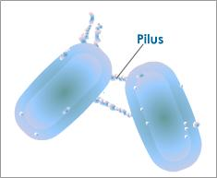
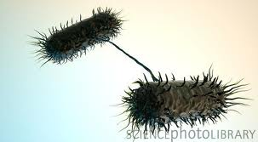
Sexual Reproduction
Sexual reproduction is when two parents combine their genetic material to produce a new organism, which differs from both parents
Conjugation is when one bacterium transfers some genetic material to another bacterium through a threadlike bridge
After the transfer, the cells separate
Conjugation does not increase the number of bacteria, but it does result in bacteria that are genetically different

Slide 29
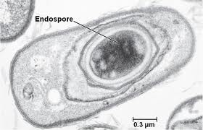
Endospore Formation
Some bacteria can survive harsh conditions by forming endospores
An endospore is a small, rounded, thick walled, resting cell that forms inside a bacterial cell
Because endospores can resist freezing, heating, and drying, they can survive for many years
Endospores are also light and a breeze can lift and carry them to new places
If an endospore lands in a place where conditions are suitable, it opens up and begins to grow and multiply

Slide 30
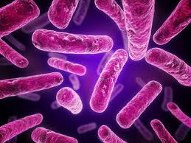
The Role of Bacteria in Nature
Strep throat, ear infections, and other diseases are caused by bacteria
Most bacteria are either harmless or helpful to people
Bacteria are involved in oxygen and food production, environmental recycling and cleanup, and in health maintenance and medicine production

Slide 31
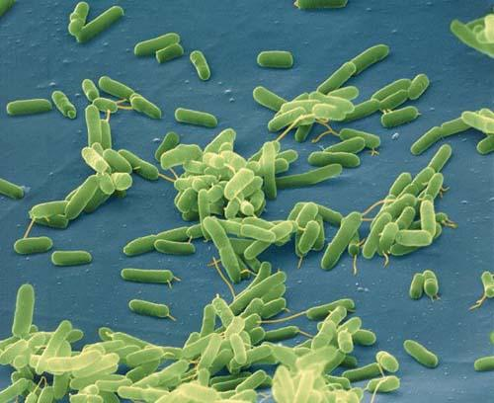
Oxygen Production
The air you breathe depends in part on bacteria
Bacteria releases oxygen into the air
Scientists believe autotrophic bacteria were responsible for first adding oxygen to the Earths atmosphere
Today, the distant offspring of those bacteria help keep oxygen levels in the air stable

Slide 32
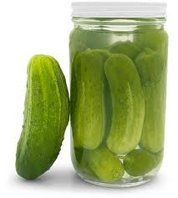
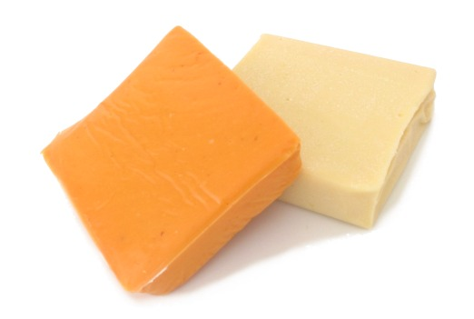
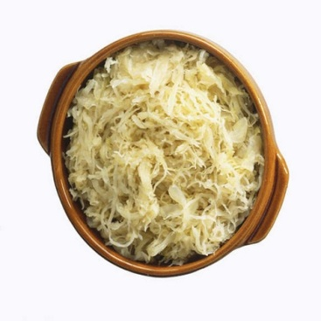
Food Production
Cheese, sauerkraut, and pickles are produced from bacteria
Some bacteria causes food to spoil when they break down the foods chemicals
Spoiled food usually smells or tastes foul and can make you very sick
Refrigerating and heating foods are two ways to slow down food spoilage

Slide 33
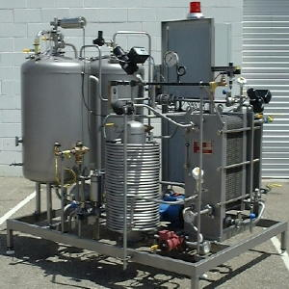
Food Production
Pasteurization, is most often used to treat beverages such as milk and juice
Pasteurization is when the food is heated to a temperature that is high enough to kill most harmful bacteria without changing the taste of the food
This process was named after Louis Pasteur, its inventor

Slide 34
Environmental Recycling
Decomposers are organisms that break down large chemicals in dead organisms into small chemicals
Decomposers are “nature’s recyclers” because they return basic chemicals to the environment for other living things to reuse

Slide 35
Environmental Recycling
Nitrogen fixing bacteria help plants survive
Nitrogen fixing bacteria live in the soil and in swellings on the roots of certain plants, such as peanuts, peas and soybeans
These helpful bacteria convert nitrogen gas from the air into nitrogen products that plants need to grow
On their own, plants cannot use nitrogen present in the air
Therefore, nitrogen fixing bacteria are vital to the plants survival

Slide 36
Environmental Recycling

Slide 37
Environmental Cleanup
Some bacteria help to clean up Earth’s land and water
Some bacteria convert the poisonous chemicals in oil into harmless substances
Scientists have put these bacteria to work cleaning up oil spills in oceans and gasoline leaks in the soil under gas stations

Slide 38
Health and Medicine
Many of the bacteria living in your body actually keeps you healthy
In your digestive system, some bacteria help you digest food and some make vitamins your body needs.
Others compete for space with disease causing organisms, preventing the harmful bacteria from attaching to your intestines and making you sick

Slide 39
Health and Medicine
Scientists have put some bacteria to work making medicines and other substances
In the 1970’s, scientists used engineered bacteria to produce human insulin
Thanks to bacteria's fast rate of reproduction, large numbers of insulin making bacteria can be grown in huge vats
The human insulin they produce is then purified and made into medicine for people with diabetes

